Slide 1
NJ Business Action Center
Resources for Recovery & Growth
MELANIE WILLOUGHBY
EXECUTIVE DIRECTOR

Slide 2
LONG HISTORY OF SERVICE TO NJ BUSINESSES
Over Thirty Years of Service to the NJ Business Community
Three Offices Devoted to Business Advocacy
Office of Business Advocacy – Help with real estate site searches, to find the right location whether growing or consolidating in response to the changing COVID environment
Office of Small Business Advocacy – From startups to main street, help small businesses access a variety of resources and answer all their questions
Office of Export Promotion – Companies interested in global business activities can tap into a number of resources, like creating an export plan, guidance in identifying global export markets, guiding you through foreign custom procedures

Slide 3
SO HOW CAN THE NJBAC HELP YOU?
Think of the NJBAC as Your Connector
Connects you with the technical assistance you need for a fiscal stability and business continuity, like writing a business plan
Identifies critical access to capital and local, state and federal grant and loan programs, like the SBA, EDA, CDFI’s, local banks
Provides guidelines for operating your business safely and identifies access to PPE https://forms.business.nj.gov/ppevendor/list/
Clarifies State mandated employee benefits, like earned sick leave
Identifies the licensing and certification requirements you need to operate

Slide 4
SO HOW CAN THE NJBAC HELP YOU?
Think of the NJBAC as Your Connector
Our team at the NJBAC knows all of the state departments and agencies and outside organizations that can directly answer your question, solve your problem, and provide you with resources and technical assistance
NJBAC connects you with:
New Jersey Economic Development Authority
New Jersey Treasury Department
New Jersey Department of Labor and Workforce Development
NJ Consumer Affairs Division
New Jersey Department of Community Affairs
New Jersey Small Business Development Centers
Programs available from your County or Municipality

Slide 5
SMALL BUSINESS ADVOCACY
Mentoring Assistance - From creating a business plan to preparing financial statements or developing valuable social media strategies having a business mentor can help your business succeed. NJBAC will connect you with programs around the state that offer one on one mentoring opportunities
Financial Resources – Will refer you to all the financing options available to your business. We can identify the specific programs for which your business may be eligible and help locate the resources that best meet your needs. Furthermore, we can assist you with credit repair services to help position a favorable application process
Licensing and Professional Certifications - Help you trouble shoot issues you may encounter with licensing or professional certifications

Slide 6
SMALL BUSINESS ADVOCACY
Navigating Regulatory Processes - Advocating on your behalf, we coordinate with other state departments to quickly identify any challenges and formulate a sound and effective solution. We can also provide redevelopment guidance and coordination for municipalities and developers
Labor and Workforce Issues - Guide companies through the variety of state training grants and resources to help you recruit the best staff or train new and current employees. Advocates can help provide information on issues regarding employer responsibilities
Procurement Assistance - Offers a variety of resources to help small companies become government contractors. From training and technical assistance, to email notification of requests for proposal (RFPs), we can provide businesses with essential information and be better positioned to compete for government contracts

Slide 7
New Jersey CLEAN ENERGY PROGRAM
New Jersey’s Energy Efficiency Program Transition
In 2018, Governor Murphy signed into law the Clean Energy Act to significantly overhaul New Jersey’s clean energy systems to:
  Build Sustainable Infrastructure
  Fight Climate Change
  Reduce Carbon Emissions
  Create Well-Paying Local Jobs
  Grow the State’s Economy
  Improve Public Health
  Ensure a Cleaner Environment for Current and Future

Slide 8
New Jersey CLEAN ENERGY PROGRAM
New Jersey’s Energy Efficiency Program Transition
  The Board of Public Utilities had previously provided businesses with the energy efficiency programs
  The new law now requires New Jersey’s investor-owned gas and electric utility companies to reduce their customers’ use of gas and electricity by set percentages over time and to handle their business customers’ energy efficiency programs
  The Board of Public Utilities approved a comprehensive suite of efficiency programs that would transition the state to some of the highest energy savings in the country. https://www.nj.gov/bpu/newsroom/2020/approved/20200610.html
  While NJ Clean Energy Program will continue to offer some energy efficiency programs, all of the investor-owned gas and electric utility companies will now also offer complementary energy efficiency programs directly to their customers

Slide 9
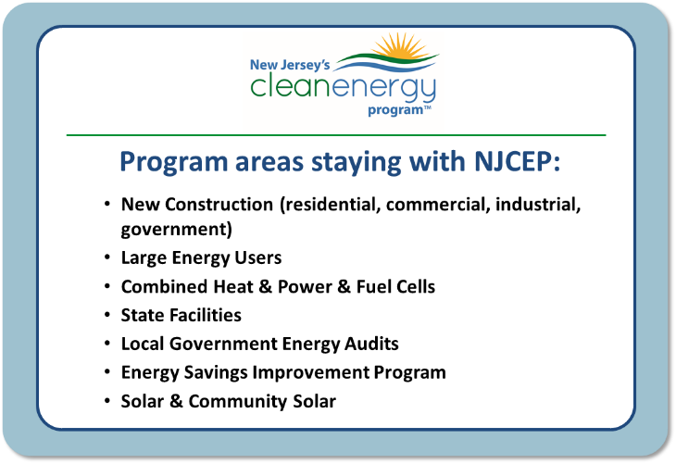
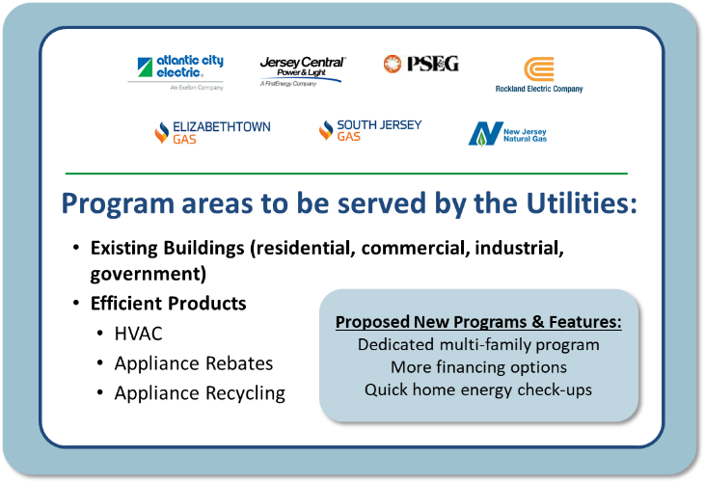
New Jersey CLEAN ENERGY PROGRAM

Slide 10

business.nj.gov
    Robust search function providing immediate targeted answers
    Plan, Start, Operate, Grow content crafted around where you are in your journey as a business
    Business Starter Kits – jump start your development with one of these kits, food trucks, online commerce, cleaning services, restaurants, etc.
    Over 100 FAQs detailing important state agency services for businesses
    Live Chat, powered by NJBAC Business Experts – making contact with state government very easy
    Create a Business Plan – Step by step process provided to help craft game plan, hone product, understand customer base and guide decision-making to set up business for success
    Filings and Accounting – Find due dates for important license renewals, tax statements, and reporting forms, as well as information on how to file annual reports and access Premier Business Services
    Contract with the State – Step by step process for many opportunities for a wide variety of business sectors to do business with the State

Slide 11
business.nj.gov/covid
NJBAC has answered over 60,000 questions from businesses using the live chat feature of the website and the NJBAC Hotline https://business.nj.gov/covid
NJBAC answers COVID-19 questions as the Governor and agencies issue new orders and standards and programs
  Access to Personal Protective Equipment (PPE)
  Details on COVID -19 Safety Protocols on state and federal levels
  Details on COVID-19 State Government Executive Orders, NJ Dept of Health Administrative Orders and State Police Administrative Orders
  Links to Access To Capital, Grants And Loans
  Access to Technical Assistance through the Small Business Development Centers
  What To Do If My Employees Have COVID?

Slide 12
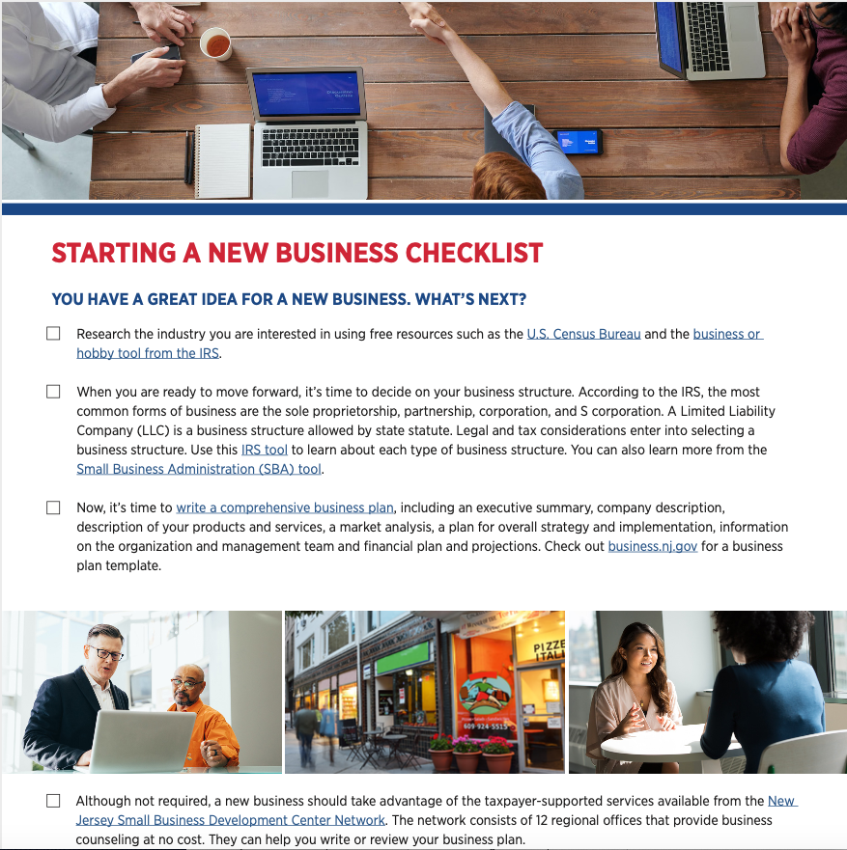
Business Checklist
You can download your copy of “Starting A New Business Checklist” available in both English & Spanish and share with your colleagues.
https://www.nj.gov/state/bac/assets/pdf/nj-new-business-checklist.pdf

Slide 13
ECONOMIC RECOVERY ACT OF 2020
NJ Economic Recovery Act
The act created a package of:
Tax incentives to incentivize job creation and capital investment
Investment tools to support and strengthen NJ’s innovation economy
Tax credits to strengthen NJ’s communities including revitalization of brownfields and preservation of historic properties
Financial resources for small businesses, including those impacted by the COVID-19 pandemic
Support for new supermarkets and healthy food retailers in food desert communities
Additional tax credits for film and digital media
  https://www.njeda.com/economicrecoveryact/#Programs

Slide 14
ECONOMIC RECOVERY ACT OF 2020
NJ Economic Recovery Act
Aspire is a gap financing tool to support commercial, mixed use, and residential real estate development that is located in a designated “incentive area”
Emerge encourages economic development in priority sectors by providing per-job tax credits for up to seven years
The Brownfields Redevelopment Incentive a $50 million per year competitive, project-based one-time transferrable tax credit for environmental remediation, abatement, and demolition for redevelopment of brownfields sites for commercial, retail, or mixed-use
  The Food Desert Relief Program addresses the food security needs of communities across New Jersey by providing tax credits, loans, grants, and/or technical assistance to increase access to nutritious foods and develop new approaches to alleviate food deserts
  You can review all the Programs & Funding available through the NJEDA at
  https://www.njeda.com/economicrecoveryact/#Programs

Slide 15
ECONOMIC RECOVERY ACT OF 2020
NJ Economic Recovery Act
  The New Jersey Innovation Evergreen Fund (NJIEF) is a partnership with the private sector that will raise and invest funds in New Jersey-based companies to address New Jersey’s shortfalls in venture capital funding and create the conditions necessary for entrepreneurs to succeed
Main Street Recovery Fund is a fund to support New Jersey micro business owners and participating entities that can serve New Jersey micro businesses, such as Community Development Financial Institutions (CDFIs) and Economic Development Corporations that is less than $1 million in annual revenue according to its most recent return and have fewer than 10 full-time employees
PPE Manufacturing Tax Credit makes $10 million in investment tax credits per year available to businesses that invest in the production of PPE during the 2020-2022 tax years to support investment in PPE manufacturing facilities and equipment to increase availability of critical public healthcare products and create manufacturing jobs

Slide 16
ECONOMIC RECOVERY ACT OF 2020
NJ Economic Recovery Act
  The New Jersey Film and Digital Media Tax Credit Program provides a transferable credit against the corporate business tax and the gross income tax for qualified expenses incurred for the production of certain film and digital media content in NJ
The Community-Anchored Development Program allows the NJEDA to facilitate and partner on large-scale development projects with desirable employment and geographical characteristics that impact the broader community. Through the program, anchor institutions in the areas of education health care, culture, community development, and economic development can use proceeds from the sale of State tax credits to act as investors in targeted development projects
  You can review all the Programs & Funding available through the NJEDA at
  https://www.njeda.com/economicrecoveryact/#Programs

Slide 17
ECONOMIC RECOVERY ACT OF 2020
NJ Economic Recovery Act
Angel Investor Tax Credit Program establishes tax credits against corporation business or gross income taxes based on a qualified investment in a NJ emerging technology business or in a qualified venture fund for the purposes of stimulating investment
  The Economic Redevelopment and Growth (ERG) Program is an incentive for developers and businesses to address revenue gaps in development projects. It can also apply to projects that have a below market development margin or rate of return. The grant is not meant to be a substitute for conventional debt and equity financing, and applicants should generally have their primary debt financing in place before applying
  You can review all the Programs & Funding available through the NJEDA at
  https://www.njeda.com/economicrecoveryact/#Programs

Slide 18
ECONOMIC RECOVERY ACT OF 2020
NJ Economic Recovery Act
The Historic Property Reinvestment Program is a $50 million competitive tax credit program to leverage the federal historic tax credit program to support transformative rehabilitation projects of identified historic properties
The Expanded Net Operating Loss (NOL) Program enables tech and life sciences companies to sell their New Jersey net operating losses and/or research and development (R&D) tax credits for cash. Buyers can purchase tax credits at a discount and apply them to reduce taxable income
NJ Ignite provides grants to NJEDA-approved collaborative workspaces for the benefit of early stage innovation economy businesses that locate in New Jersey
The Offshore Wind Tax Credit Program provides a reimbursement for capital investment in a qualified wind energy facility located in New Jersey. The program is designed to spur employment growth and offshore wind supply chain development as a result of capital investment in land-based offshore wind industry projects

Slide 19
NJEDA SMALL BUSINESS EMERGENCY
ASSISTANCE GRANT - PHASE 4
Phase 4 of the NJEDA Small Business Emergency Assistance Grant Program will provide grants up to $20,000 to small- and medium- sized businesses and non-profits that have been negatively impacted by the COVID-19 pandemic
Interested business owners will need to pre-register at programs.njeda.com between Monday, April 19, 2021 at 9:00 a.m. and Thursday, April 29, 2021 at 5:00 p.m
Pre-registration is not first come, first served, but businesses are encouraged to begin the process as early as possible
Business that do not pre-register will not be eligible for phase 4 grants

Slide 20
NJEDA SMALL BUSINESS EMERGENCY
ASSISTANCE GRANT - PHASE 4
In order to receive a Phase 4 grant, businesses must be properly registered with the State of New Jersey.
To help business owners ensure they are properly registered, the NJEDA is hosting two Phase 4 Document Preparation Sessions with the NJ Department of Treasury.
‍Sessions will be held on Friday, April 16, 2001 at 3:00 p.m. and Monday, April 19, 2001 at 5:00p.m.
These sessions will cover what it means to be “properly registered” with the State, how business owners can check their registration status, and what to do if a business is not properly registered. Both sessions can be accessed through zoom on business.nj.gov. When asked to enter a password, type: GRANT

Slide 21
NJEDA SMALL BUSINESS EMERGENCY
ASSISTANCE GRANT - PHASE 4
Following pre-registration, applications will become available on a rolling basis. Pre-registered applicants will need to return to programs.njeda.com to complete an application based on the following schedule:
  Businesses that did not apply for, or were not approved for Phase 3 funding – 9:00 a.m. on May 3, 2021
  Check if you previously received funding for phase 1, phase 2 or phase 3
  Restaurants and child care providers – 9:00 a.m. on May 5, 2021
  Micro businesses (five or fewer FTEs) – 9:00 a.m. on May 10, 2021
  All other small businesses – 9:00 a.m. on May 12, 2021
Applications for each category will be open for a period of one week and will be accepted on a first-come, first-served basis, based upon the date and time the Authority receives a completed application submission.

Slide 22
NJEDA SMALL BUSINESS EMERGENCY
ASSISTANCE GRANT - PHASE 4
Grant awards will be calculated based on the number of full-time equivalent employees (FTEs) businesses employ
Micro-businesses with five or fewer FTEs and sole proprietorships will receive up to $10,000
Businesses with six to 25 FTEs will receive up to $15,000
Businesses with 26 to 50 FTEs will receive up to$20,000
A grant size estimator is available at: forms.business.nj.gov/grant-4/size

Slide 23
AMERICAN RESCUE PLAN
Stimulus Relief for Small Businesses
Would provide $15 billion to Economic Injury Disaster Loan program (EIDL), for long-term, low-interest loans from the SBA
Severely impacted small businesses with fewer than 10 workers will be given priority for some of the money
Would provide $25 billion for new grant program specifically for bars and restaurants
  Eligible businesses may receive up to $10 million, can use the money for expenses, including payroll, mortgage and rent, utilities and food and beverages
Paycheck Protection Program would get additional $7 billion and would make more non-profit organizations eligible

Slide 24
U.S. Small Business Administration
The Shuttered Venue Operators Grant
This program was established by the Economic Aid to Hard-Hit Small Businesses, Nonprofits, and Venues Act, and amended by the American Rescue Plan Act
Includes over $16 billion in grants to shuttered venues, to be administered by SBA’s Office of Disaster Assistance
Eligible applicants may qualify for grants equal to 45% of their gross earned revenue, with the maximum amount available for a single grant award of $10 million. $2 billion is reserved for eligible applications with up to 50 full-time employees
  Live venue operators or promoters
  Theatrical producers
  Live performing arts organization operators
  Relevant museum operators, zoos and aquariums who meet specific criteria
  Motion picture theater operators
  Talent representatives
https://www.sba.gov/funding-programs/loans/covid-19-relief-options/shuttered-venue-operators-grant

Slide 25
Office of Export Promotion

Slide 26

Office of Export Promotion
Did You Know . . .
More than 95% of the world’s consumers are outside of the U.S.

Slide 27
Office of Export Promotion
Did You Know . . .
Exporting can be profitable for businesses of all sizes

Slide 28
Office of Export Promotion
Did You Know . . .
There are NJ resources to assist your firm’s exporting efforts

Slide 29
Office of Export Promotion
Supports Companies Exporting
Assesses export readiness of business, develops an export plan
Identifies informational opportunities about exporting basics, regulatory compliance, customs procedures, and reporting
Collaborates with state and federal agencies to support growth of global sales
Identifies global business opportunities, helps locate buyers
Encourages small and medium-sized exporters to expand into other countries
Notes:
29

Slide 30

Office of Export Promotion
NJ State Trade Expansion Program (NJ STEP)
Designed for eligible small businesses that are either:
    New to exporting
    Currently selling their goods & services in other countries
    Funded in part through a Grant with the U.S. Small Business Administration
          Financial awards based upon a first come, first serve competitive basis
Notes:
30

Slide 31
Office of Export Promotion
NJ State Trade Expansion Program (NJ STEP)
s Financial awards to partially offset export promotion costs
Foreign Trade Missions
Subscription Fees to Data Bases
Website/E-Commerce
Translation of Websites (audio and/or video)
Design and/or Translation of Marketing Material/Media with International Focus
Trade Show Booth Exhibition
Reverse Trade Missions
Notes:
Foreign Trade Missions
Includes in-person or virtual/online participation
Business Match Making Service
Individual interpreter cost during event
Subscription Fees to Data Bases
All U.S. Department of Commerce – Commercial Services
Business Match Making Service, Export-Market Research Tool
Product Compliance Testing for Market Entry

Slide 32
Office of Export Promotion
NJ State Trade Expansion Program (NJ STEP)
  a
  Application may be found through the following link:
  https://www.nj.gov/state/bac/bac-njstep.shtml
Questions may be directed to William Spear at: william.spear@sos.nj.gov
Call the New Jersey Business Action Center at: 1‑800‑JERSEY‑7
Notes:
32

Slide 33


Office of Export Promotion
NJ State Trade Expansion Program (NJ STEP)
Like all businesses, the winery was faced with a new uncertainty, wondering what a global pandemic would mean to the company and its employees. Tastings, weddings and other events would be affected the most, but the winery has seen growth and success thanks to its early embrace of the possibilities of e-commerce and its work to pursue exporting with the help of grants received through the Office of Export Promotion New Jersey State Trade Expansion Program. Owner Jack Tomasello estimated e-commerce sales are up some 37 percent since March, when New Jersey declared a public health emergency.
Notes:
33

Slide 34

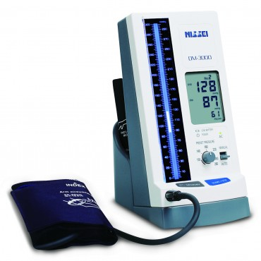
Office of Export Promotion
NJ State Trade Expansion Program (NJ STEP)
Princeton-based CAREOX has been in the respiratory industry for some 30 years. While focused on health and safety of his employees due to Covid, the company continued exporting its products to places like South Korea, Japan, Turkey and the European Union. CAREOX, a recipient of two NJ State Trade Expansion Program grants, used the funds to attend trade shows to reach potential new customers. Advocates from the Office of Export Promotion, part of the New Jersey Business Action Center, assisted CAREOX during the application process. The Office of Export Promotion administers the grants.
Notes:
34

Slide 35
Government Procurement

Slide 36
Government Procurement
Procurement is important in business because it directly impacts a company's profit margin
Federal government procurement by public authorities in the United States accounts for about $7 trillion annually, making government in the United States the largest purchaser of goods and services in the world
Government procurement is necessary because government does not produce the goods they need, they count on the private sector
This presentation will only scratch the surface, but it will provide resources at the end where you can get technical assistance to help you plan for penetrating this new market and help you navigate its complexities
Notes:
36

Slide 37
Government Procurement Basics
Participating in government contracts can be lucrative, especially for a small business. However, it is also complicated and highly regulated
Purchasing authorities have two, sometimes competing goals that can create conflicts
  Purchase Agents have a responsibility to the taxpayer to secure the goods and services necessary to conduct the State’s business in the most cost-effective way possible
  Purchase Agents are also tasked with using the purchasing power to support the NJ businesses community, especially small, minority, woman or veteran owned businesses and other diverse suppliers

Slide 38
Four Separate Laws Govern Procurement
  Four separate laws and regulations govern government procurement
  Although they have similarities, each law is unique and must be understood by those seeking to become a vendor to this branch of government
    Federal Procurement (various federal statutes) visit The Office of Federal Procurement for a summary (www.whitehouse.gov/omb/management/office-federal-procurement-policy)
    State Procurement N.J.S.A. 52:34-6
    County/Municipal Procurement N.J.S.A. 40A:11-1 et seq
    School Districts N.J.S.A. 18A:18A-1 et seq.
Notes:
38

Slide 39
State Certifications
  Important when pursuing State funded contacts or with Diversity Offices in the private sector (Office Depot, Verizon, Citi Bank, Walmart, NJ Natural Gas)
  Small Business Enterprises (SBE) NJ has a 25% set-aside
  Minority/Woman-Owned Business Enterprise (MWBE)
    New Jersey does not offer gender or race-based set asides at this time
    County Set-aside programs in Mercer, Essex, Hudson and Bergen Counties
  Veteran-Owned Enterprise (VOB)
  Disabled Veteran-Owned Business Enterprise (DVOB) NJ has a 3% set-aside
  There is a single Uniform application form at www.njportal.com/DOR/SBERegistry
Notes:
39

Slide 40
State Government Procurement
The Division of Purchase and Property (DPP), within the Department of the Treasury, was created under N.J.S.A. 52:18A-3. It serves as the State's central procurement agency
The DPP professionally and ethically procures the best valued products and services, in a timely and cost-effective manner in accordance with State laws and regulations, to enable client agencies to meet their objectives
There are other contracting opportunities with other state, county, and local government subdivisions
Cooperative purchasing groups can also play a large role in procurement. The Education Services Commission of NJ provides cooperative purchasing opportunities to 700 school districts and municipalities
Notes:
40

Slide 41
Good Place To Start
  NJ START (NJSTART.gov) is the state’s e-procurement system used primarily by the Division of Purchase and Property
  A registration process for all potential and current vendors
  Bidding opportunities from the Division of Purchase and Property (DPP)
  Searchable for Current Contracts
  Payments are processed through NJ START
  Can check for expiring contracts as a potential bid opportunity
  Video available at https://nj.gov/treasury/purchase/njstart/video/NJSTART-Premiere.mp4
Notes:
41

Slide 42
Technical Assistance Programs
  NJ Small Business Development Centers www.njsbdc.com
  Assist in putting together the plan to pursue procurement opportunities
  Funded primarily by the Small Business Administration and the NJ Business Action Center
  Best place to go when thinking about procurement opportunities
  Procurement Technical Assistance Center (PTAC)
  NJ Institute of Technology PTAC serves 20 counties in NJ www.njit.edu/ptac/
  Funded by the US Defense Logistic Agency
  Best resource when business is further along and ready to submit bids
Notes:
42

Slide 43
Technical Assistance Programs
  What do you need to successfully bid on a contract?
  Vendors must be properly registered with the State of New Jersey with a valid Business Registration Certificate
  Vendors must be Tax Compliant
  Need to demonstrate financial ability to fulfill obligations of the contract
  Vendors need to provide a Capability Statement showing experience and contracts of similar size and scope
  Patience – it takes time to learn the procurement laws and regulations and how your company can participate
  Cost is minimal except for the dedication of a staff person to learning all your company needs to know to be a procurement expert
Notes:
43

Slide 44
Technical Assistance Programs
  Other important considerations
  The majority of small businesses or first-time vendors start as subcontractors for the contract holder or “Prime” on the contract
  A subcontractor can help a “Prime” satisfy their set-aside obligations
  The technical assistance programs are vital for ensuring a business is successful in this new market
  It can take up to a year from the development of a plan to submitting a bid
  NJBAC Contact for Procurement Questions
    Donald Newman, Manager, NJBAC Office of Small Business Advocacy
    Donald.newman@sos.nj.gov
    1-800-JERSEY-7

Slide 45
IMPORTANT WEBSITES & NJBAC HOTLINE
New Jersey Business Action Center https://www.nj.gov/state/bac/
Business Helpline: 1-800-JERSEY-7
Ask our Live Chat
https://business.nj.gov/
NJ Business Website
https://business.nj.gov
COVID-19 Business Website
https://business.nj.gov/covid
Melanie Willoughby, Executive Director Melanie.Willoughby@sos.nj.gov

Slide 46
We’re from the Businesses Action Center and We’re Here to Help Your Business Grow
Business Advocates
Irene Crespo Irene.Crespo@sos.nj.gov
Mike Mangin Michael.Mangin@sos.nj.gov
Steve Milgrom Stephen.Milgrom@sos.nj.gov
Melanie Willoughby, Executive Director
Melanie.Willoughby@sos.nj.gov

Slide 47
Resources for Recovery & Growth Virtual Series
This free, six-part webinar series presented by the NJBAC will feature tips, processes and resources from state departments and partners to help your business
Let’s Talk Resources for Nonprofits 4/20, 12-1pm
Learn about services available for nonprofit organizations from the State Library, NJ Center for Nonprofits and New Jersey State Council on the Arts.
Let’s Talk Government Procurement: Making Government Your Customer 4/22, 12-1pm
Become a vendor for the largest purchaser of goods and services in the world with information presented by the Procurement Technical Assistance Center, the Small Business Development Center, the Department of Transportation and the Treasury Certification office.
Let’s Talk Technical Assistance Opportunities 4/27, 12-1pm
Whether you are writing a business plan, planning for post-COVID recovery, applying for a financing program, or ready to expand into e-commerce, taxpayer-supported technical assistance programs are here to help you. Hear from the Small Business Development Center, SCORE and Women’s Business Center about how they can help you with the technical side of operating a business.
https://nj.gov/state/bac/bac-webinars.shtml

Slide 48
Resources for Recovery & Growth Virtual Series
This free, six-part webinar series presented by the NJBAC will feature tips, processes and resources from state departments and partners to help your business.
Let’s Talk Financial Resources 4/29, 12-1pm
Lending programs and institutions are dedicated to supporting the business community, whether you need to raise $5,000 or $5 million. Hear from the US Small Business Administration, NJEDA, and the UCEDC (a Community Development Financial Institution).
Let’s Talk COVID Safety in the Workplace 5/11, 12-1pm
Employers have new responsibilities to keep their employees safe. The Department of Labor will share how you can stay compliant.
Let’s Talk Lesser-Known Resources Provided by the Government 5/13, 12-1pm
As a business owner you need to be familiar with every opportunity for support and services available to you. Hear about some of the lesser-known resources from the State and your local Library, the NJ Urban Enterprise Zone Program, and the Department of Community Affairs’ Main Street program. Stay ahead of your competition; if you don’t use all the support available, your competitors certainly will.
https://nj.gov/state/bac/bac-webinars.shtml

Slide 49
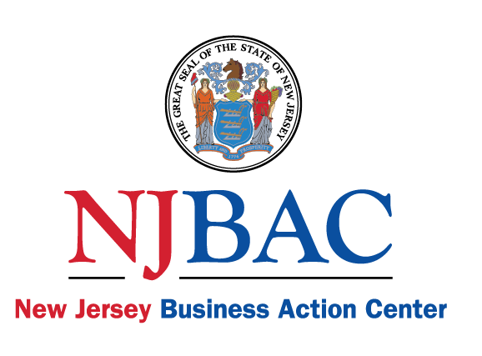
Thank You
Business Helpline: 1-800-JERSEY-7
@nj_bac
/company/new-jersey-business-action-center

